Slide 1
Powering up your data work with Excel's Power Query
ANGELA ZOSS
github.com/amzoss/power-query

Slide 2
LEARNING OUTCOMES
Articulate the benefits of reproducible data work
Find Power Query in modern versions of Excel
Connect to a data file in Power Query
Understand different types of Power Query data transformations
Build a query with a multi-step data transformation sequence
Push transformed data back to Excel for summaries and visualizations
github.com/amzoss/power-query

Slide 3
Schedule
Duration | Topic
10 minutes | Small group introductions
10 minutes | Brief presentation: Introduction to reproducibility and its connection to assessment work
15 minutes | Example data project: Aggregating event registration data from multiple files
5 minutes | Quick check-in with small groups
20 minutes | Example data project: Blend item metadata with circulation data through joins
10 minutes | Small group check-in, short break
20 minutes | Example data project: Transforming simple survey data (split multi-valued cells, unpivot)
15 minutes | Small group reflection
15 minutes | Full group Question & Answer session

Slide 4
Technical Requirements
To follow along with exercises, participants will need access to a laptop computer (Windows or Mac OS) with a recent version of Excel that supports Power Query
Windows: Excel 2016 and later, Microsoft 365, Excel for the Web
Mac: Excel for Microsoft 365 for Mac, Excel for the Web

Slide 5
Small-group introductions
10 minutes

Slide 6
Introductions
Name
Institution
Position title
Have you used Excel’s Power Query before?
What are your biggest data analysis problems right now?

Slide 7
Reproducible data analysis
10 minutes

Slide 8
What is reproducibility?
“the ability to recompute data analytic results given an observed dataset and knowledge of the data analysis pipeline.”
Leek, J. T., & Peng, R. D. (2015). Reproducible research can still be wrong: Adopting a prevention approach. Proceedings of the National Academy of Sciences, 112(6), 1645–1646.

Slide 9
Why care about reproducibility?
Open science makes review easier
Increasingly a requirement by funding agencies
Saves you a lot of time trying to figure out what you did last time!
“Your closest collaborator is you six months ago, but you don’t reply to emails.”
- Karl Broman, paraphrasing Karen Cranston quoting Mark T. Holder

Slide 10
General tips for reproducible data work
Keep original (raw) data without modification, work from a copy
Use non-proprietary, interoperable data formats (e.g., CSV)
Use data processing tools that retain a record of the processing steps (e.g., programming scripts)
Save processed data under a new file name
Create documentation to keep track of everything you do to your data, including the sources of your data, storage locations, field properties, data cleaning steps, etc.

Slide 11
Reproducibility and Excel
Common ways of using Excel are not ideal for reproducibility
Editing cells directly, with no record of the processing steps
Injecting non-data notes and documentation into data
Blending different data types in the same column
Using position and formatting to indicate data values, instead of directly encoding data

Slide 12
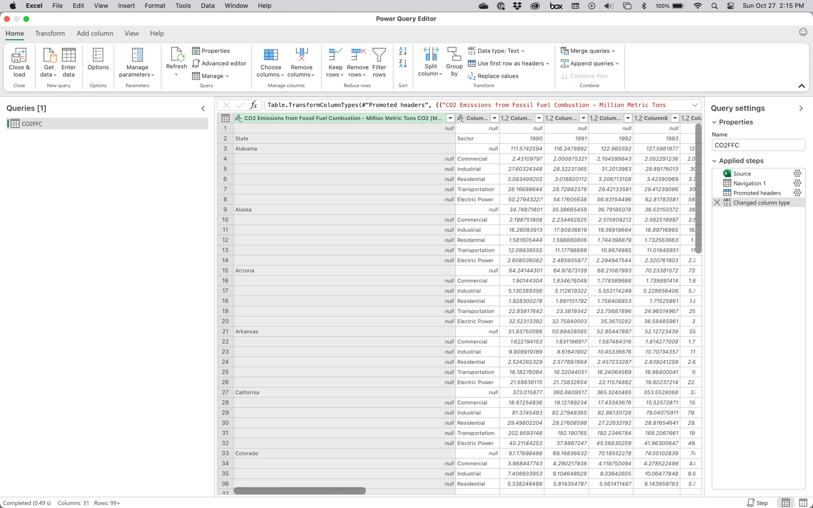
Introducing: Power Query

Slide 13
Power Query makes Excel reproducible
Keeps processed data separate from raw data
Keeps track of processing steps
Offers a wide range of data processing options, including ways to combine data from multiple sources
After processing, loads data back into Excel for additional analysis or visualization
Provides easy ways to refresh processed data when raw data changes

Slide 14
Example data project: Fix common data issues
15 minutes

Slide 15
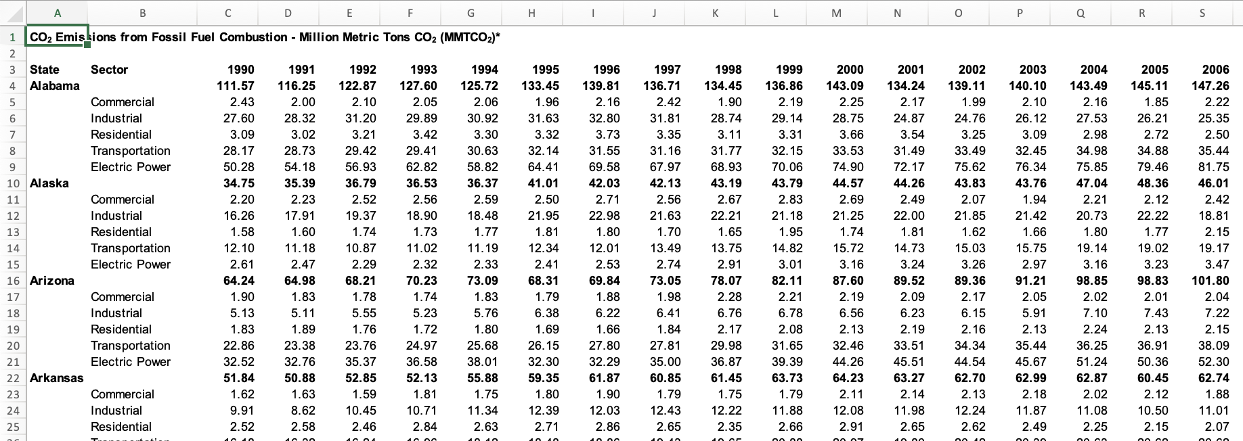
CO₂ Emissions
Source: https://www.epa.gov/statelocalenergy/state-co2-emissions-fossil-fuel-combustion

Slide 16
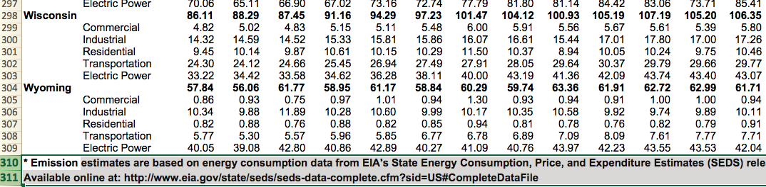
Remove empty, non-data rows

Slide 17
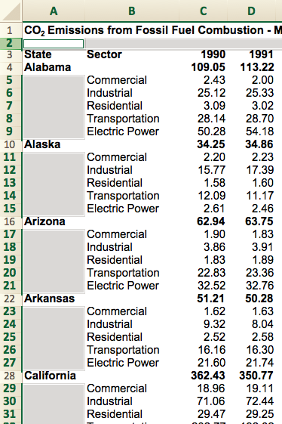
Complete incomplete rows, headers

Slide 18
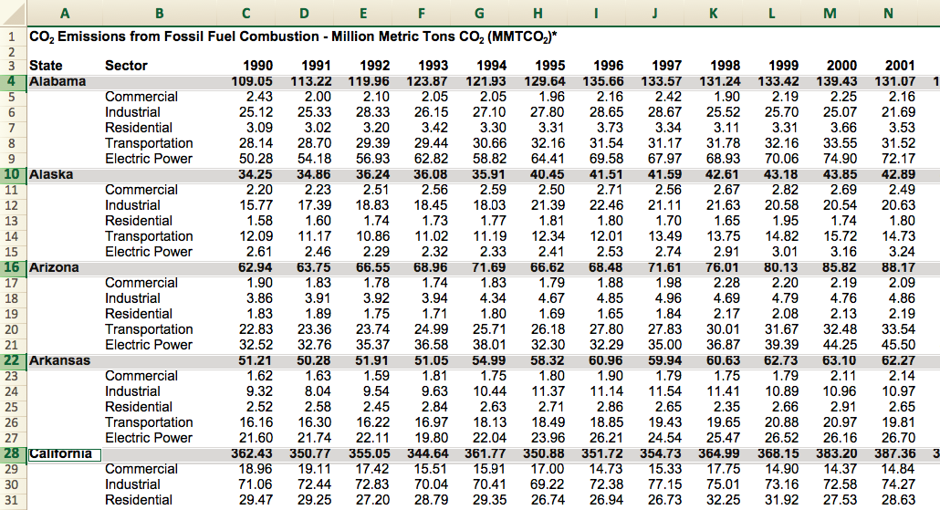
Remove sub-totals and totals

Slide 19
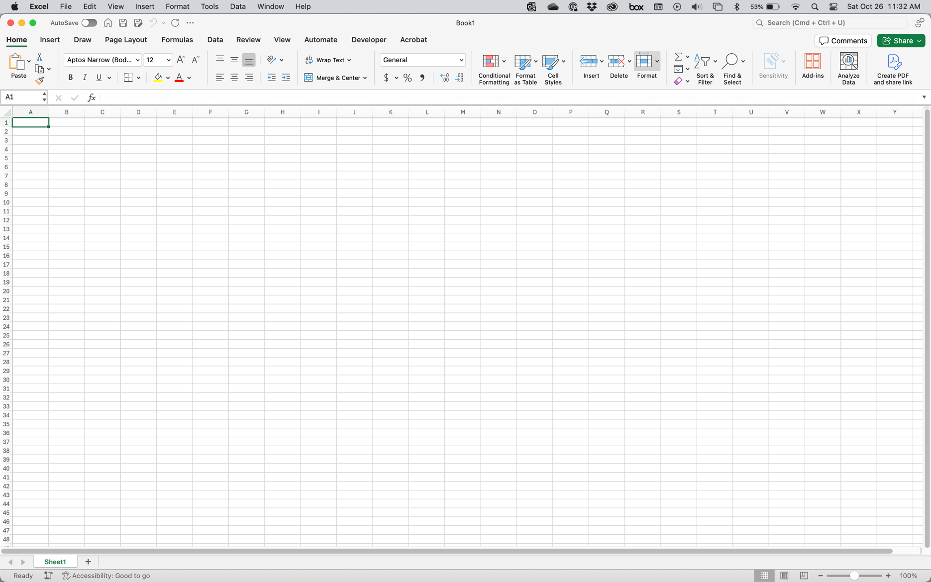
Open a blank workbook

Slide 20
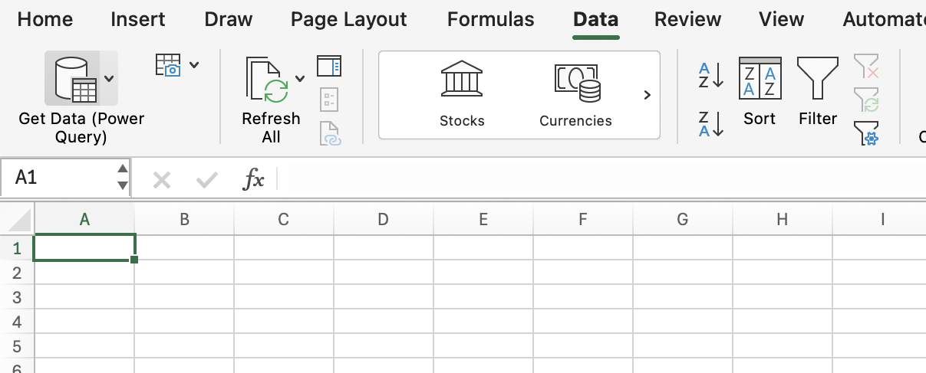
Under “Data”, click “Get Data”

Slide 21
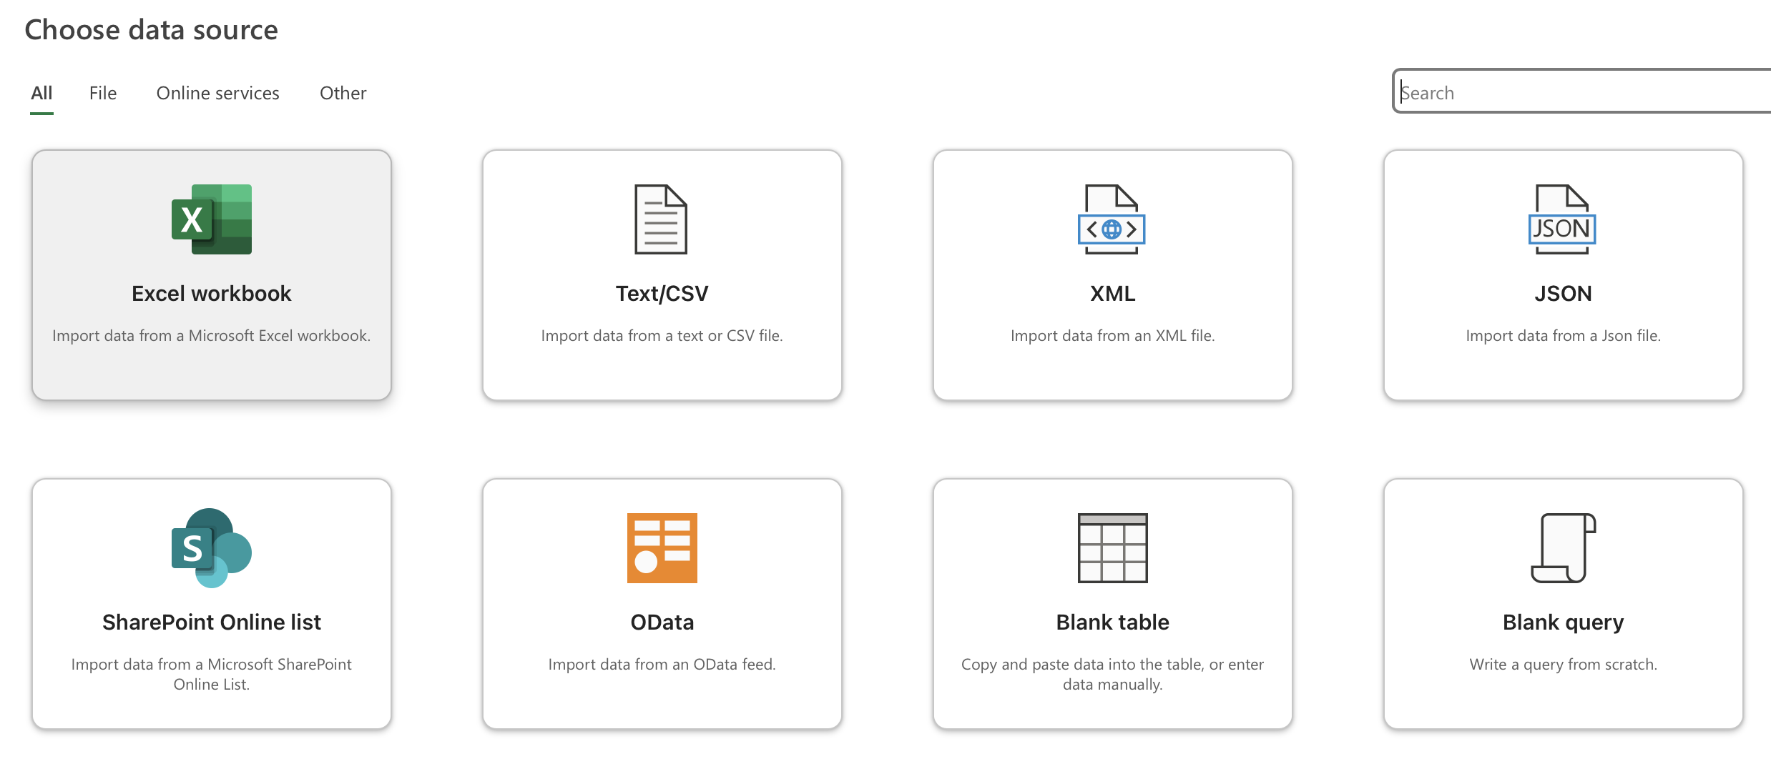
Choose data source: Excel workbook

Slide 22
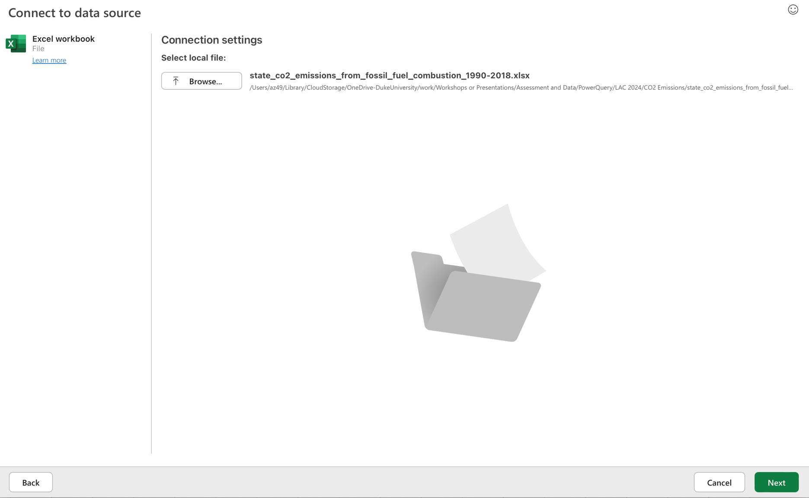
Select “state_co2…xlsx” file

Slide 23
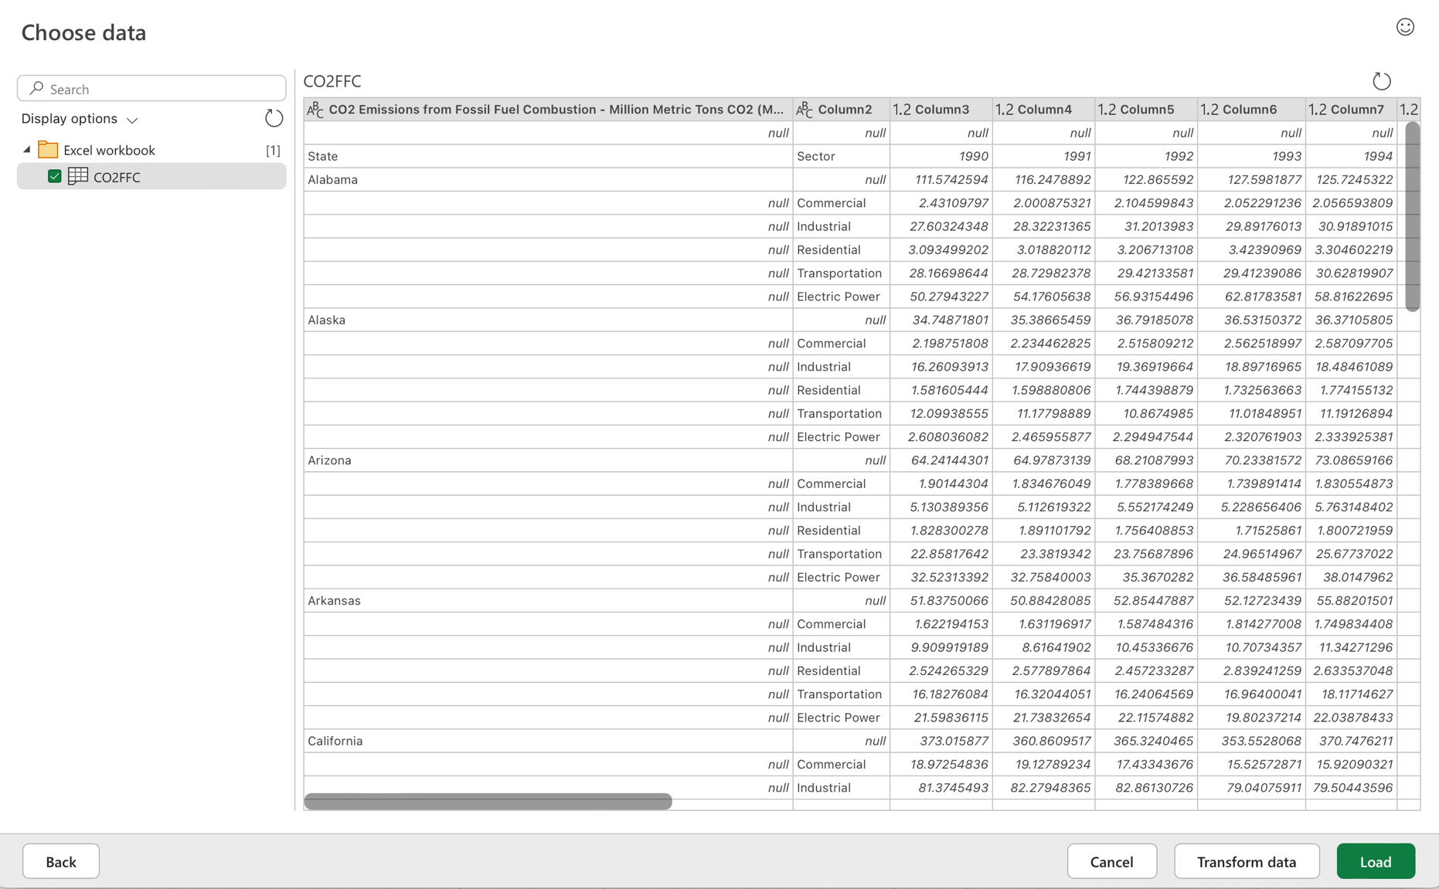
Select the “CO2FFC” sheet, check the preview, and click “Transform data”

Slide 24
Power Query Editor opens in new window
Ribbon
Query we’re working on
Data transformation
(“Applied steps”) list
Data preview

Slide 25
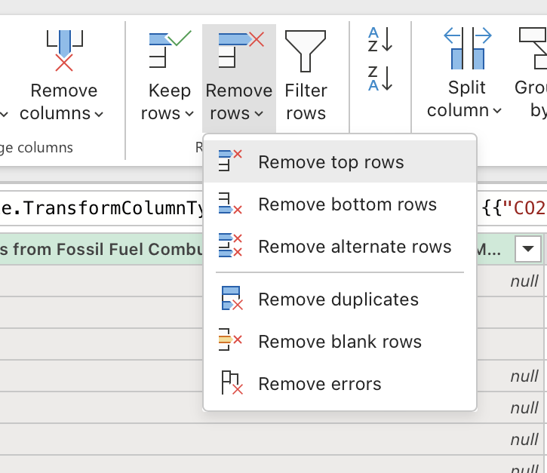
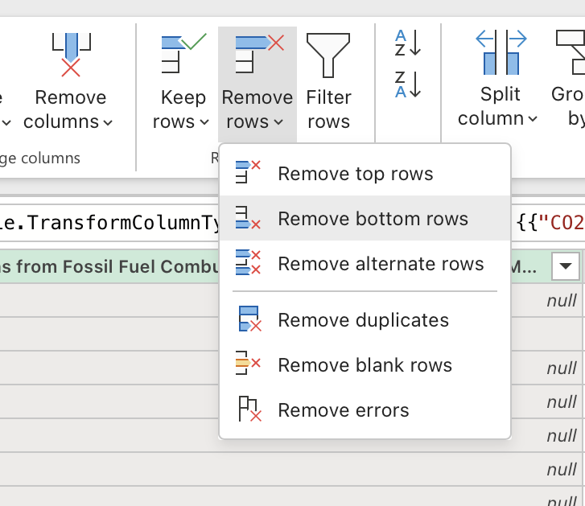
Remove non-data rows
Remove top 1 row
Remove bottom 2 rows

Slide 26
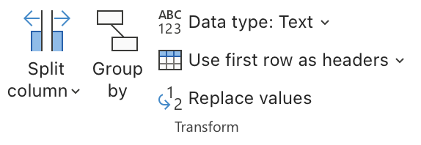
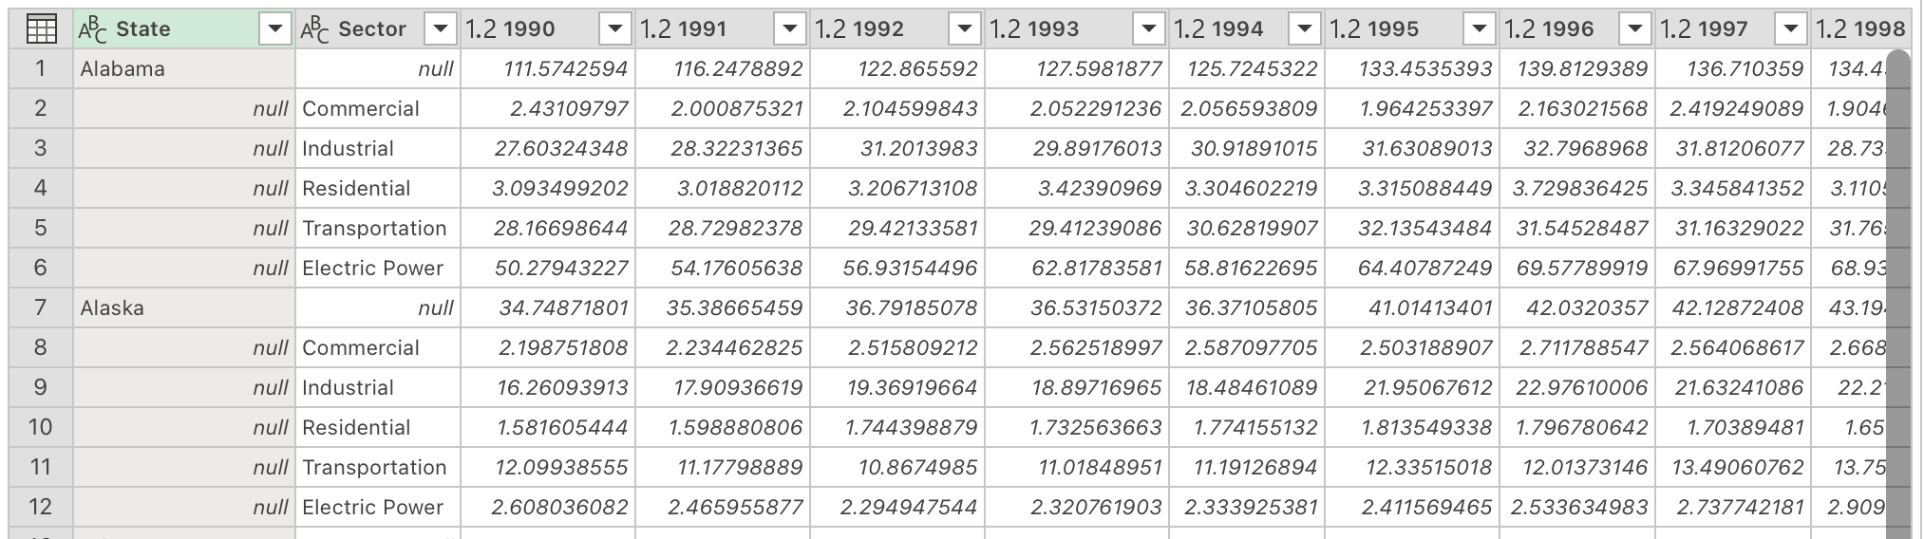
Use first row as column headers

Slide 27
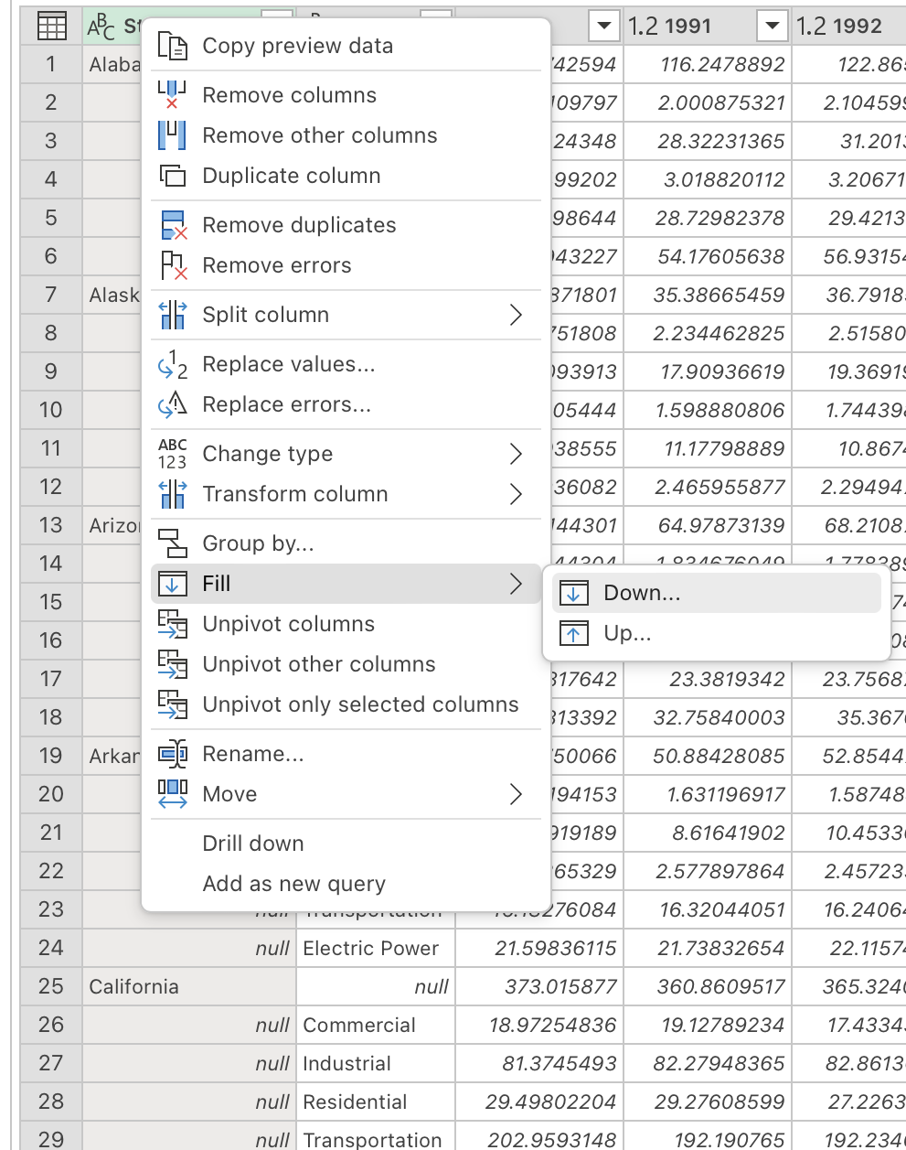
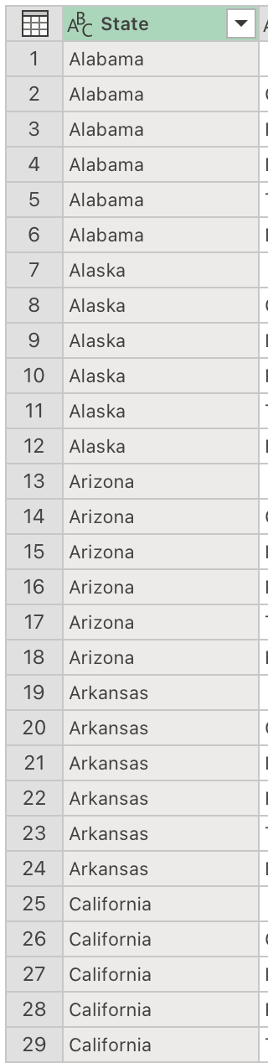
Fill in state name for all rows
Right-click “State” column header
Hover over “Fill”
Select “Down…”

Slide 28
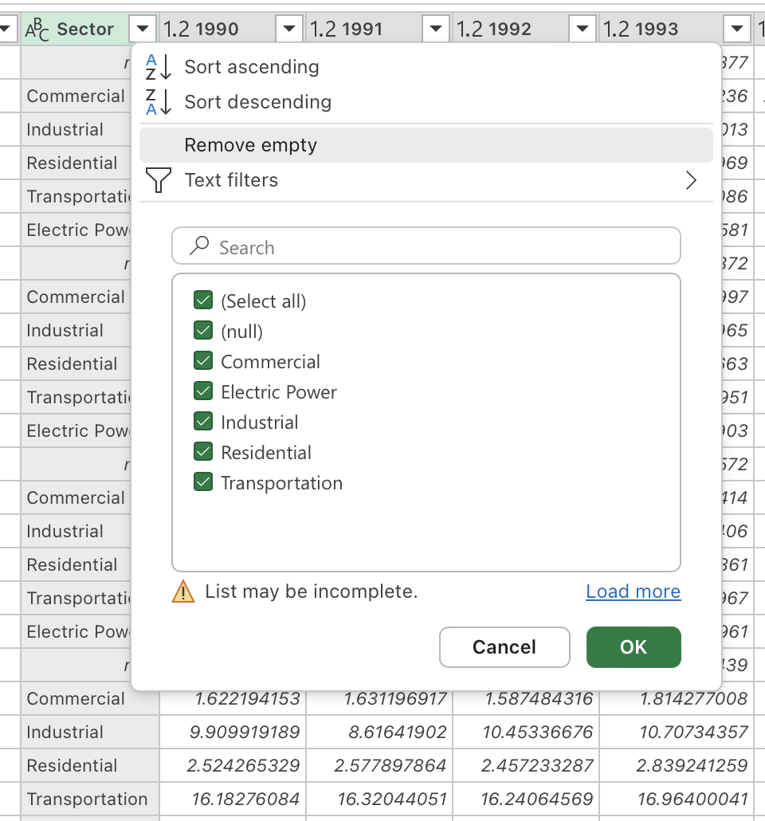
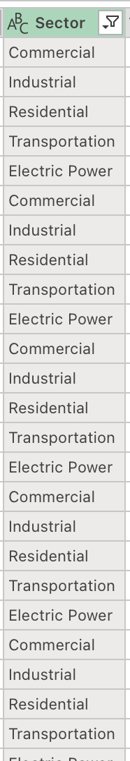
Remove subtotals
Note: Subtotal rows all have “null” in the Sector column.
Click on the filter menu for the “Sector” column
Select “Remove empty”

Slide 29
What is “tidy data”?
Tidy data is a concept that helps us organize our data so that it's in a useful format for a bunch of different tools and operations.
See also: Tidy Data lecture from Hadley Wickham, circa 2011

Slide 30
What are the features of tidy data?
Each variable is a column; each column is a variable.
Each observation is a row; each row is an observation.
Each value is a cell; each cell is a single value.
Tidy Data, from R for Data Science

Slide 31
Secret extra reason for tidy data: Pivot Tables
If you want to use Pivot Tables to summarize your data, you want to start with tidy data.

Slide 32
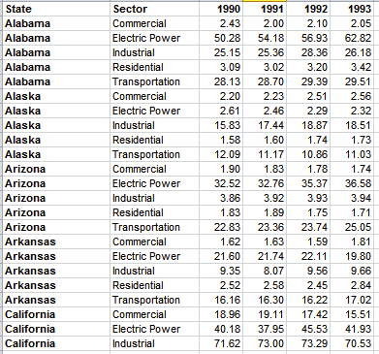
Wide data
(e.g., one column per year) good for comparing two or more measurements of the same entity

Slide 33
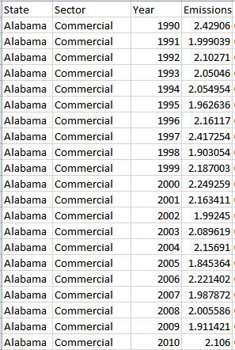
Long (“tidy”) data
(e.g., many rows per entity) good for filtering and subsetting on the fly, aggregating across measurements

Slide 34
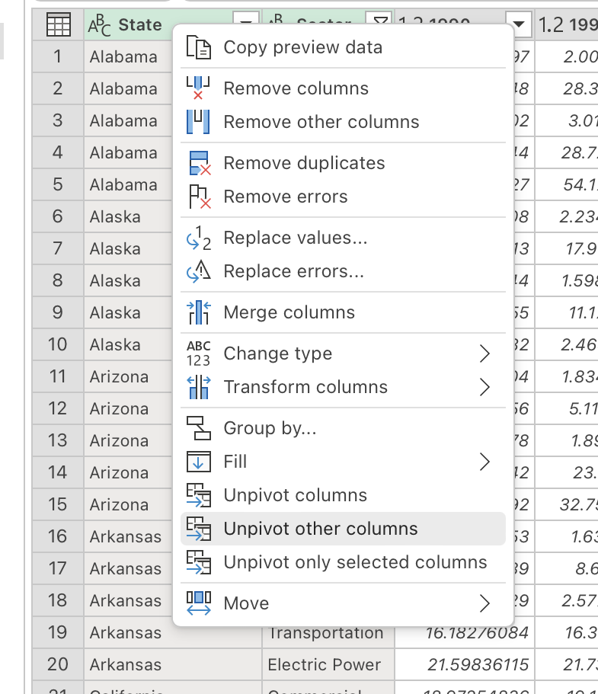
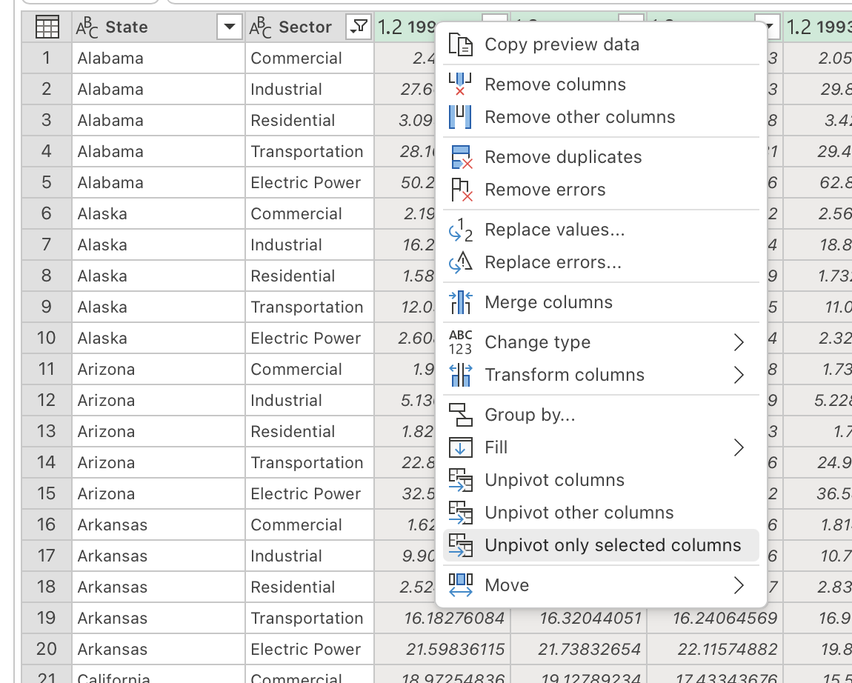
In PQ, want to “Unpivot” year columns
Option 1:
Select first two columns,
unpivot other columns
Option 2:
Select all year columns,
unpivot only selected columns

Slide 35
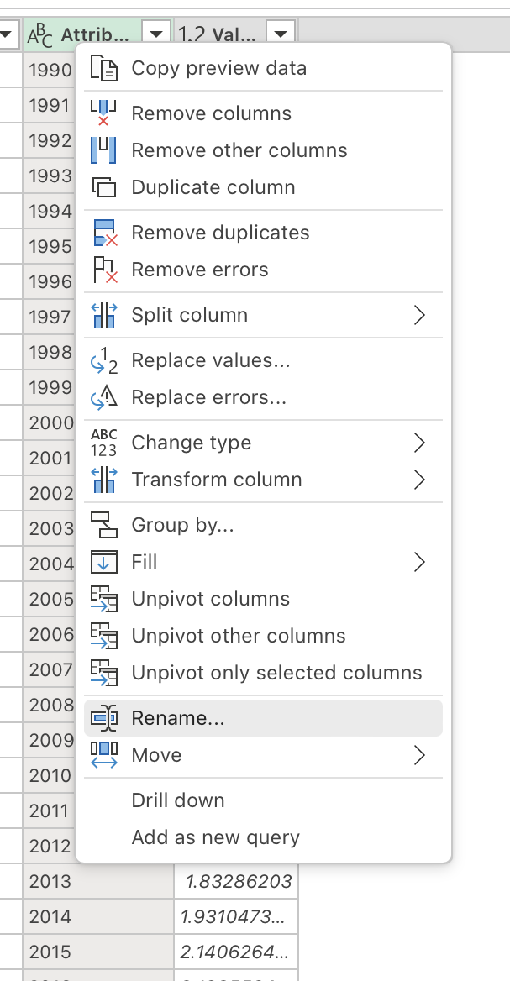
Rename new columns
“Attribute” -> “Year”
“Value” -> “Emissions”

Slide 36
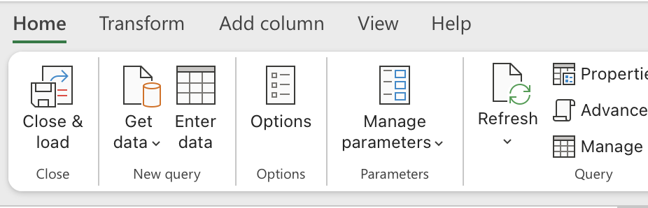
Push data back into Excel with “Close and Load”

Slide 37
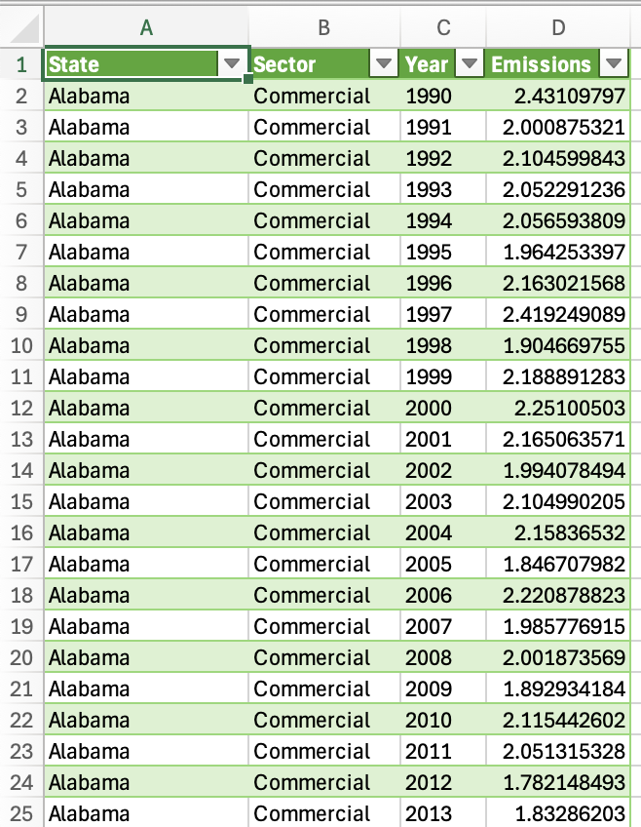
Final data in Excel

Slide 38
Quick check-in with small groups
5 minutes

Slide 39
Example data project: Additional data cleaning, appending data sources
20 minutes

Slide 40
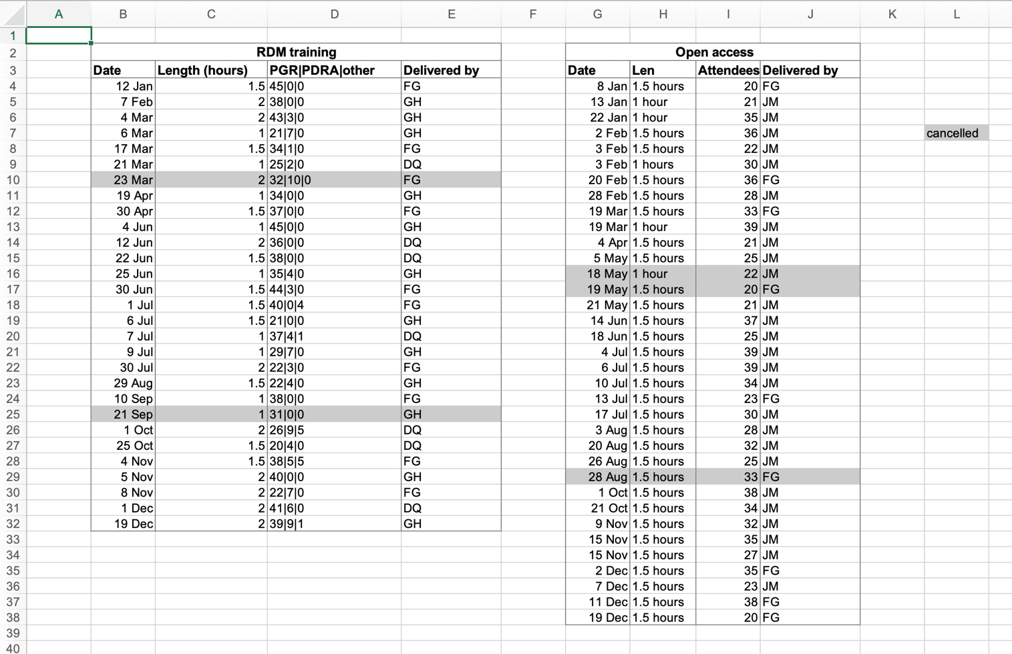
Sample training attendance data
Source: https://librarycarpentry.org/lc-spreadsheets/#data

Slide 41
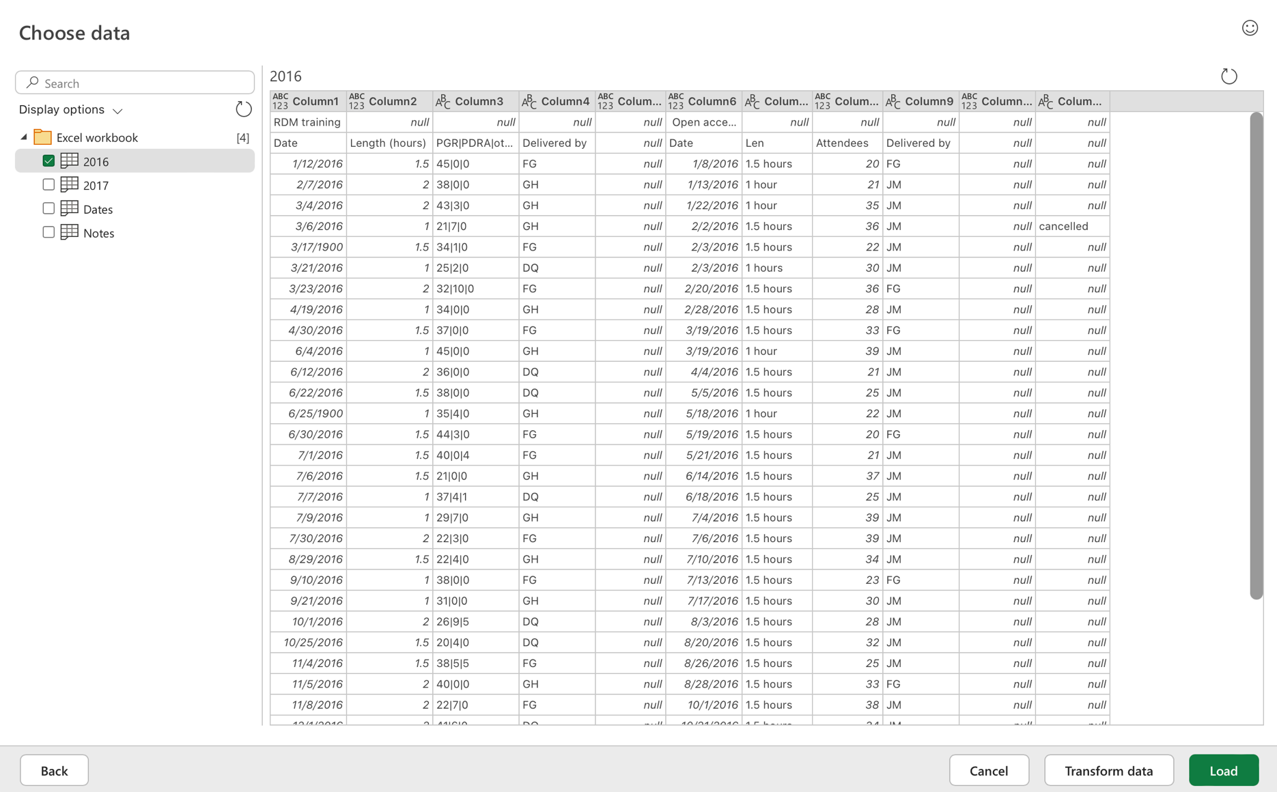
In a new Excel file, get 2016 data from “training_attendance.xlsx”

Slide 42
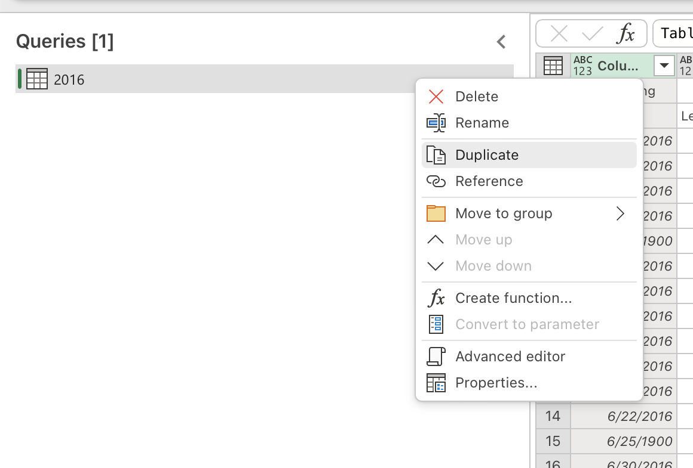
Sheet has two data tables; we can duplicate the query to deal with each

Slide 43
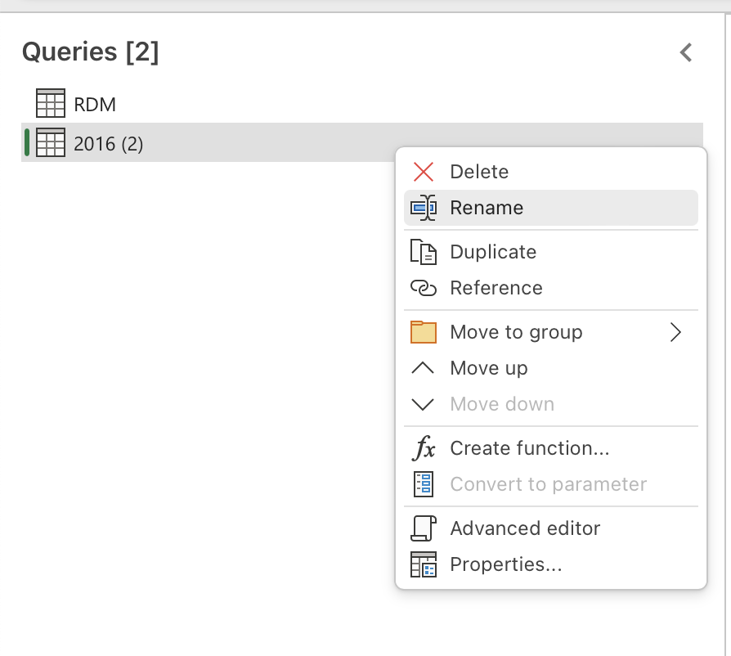
Rename each query to match data tables: RDM and Open access

Slide 44
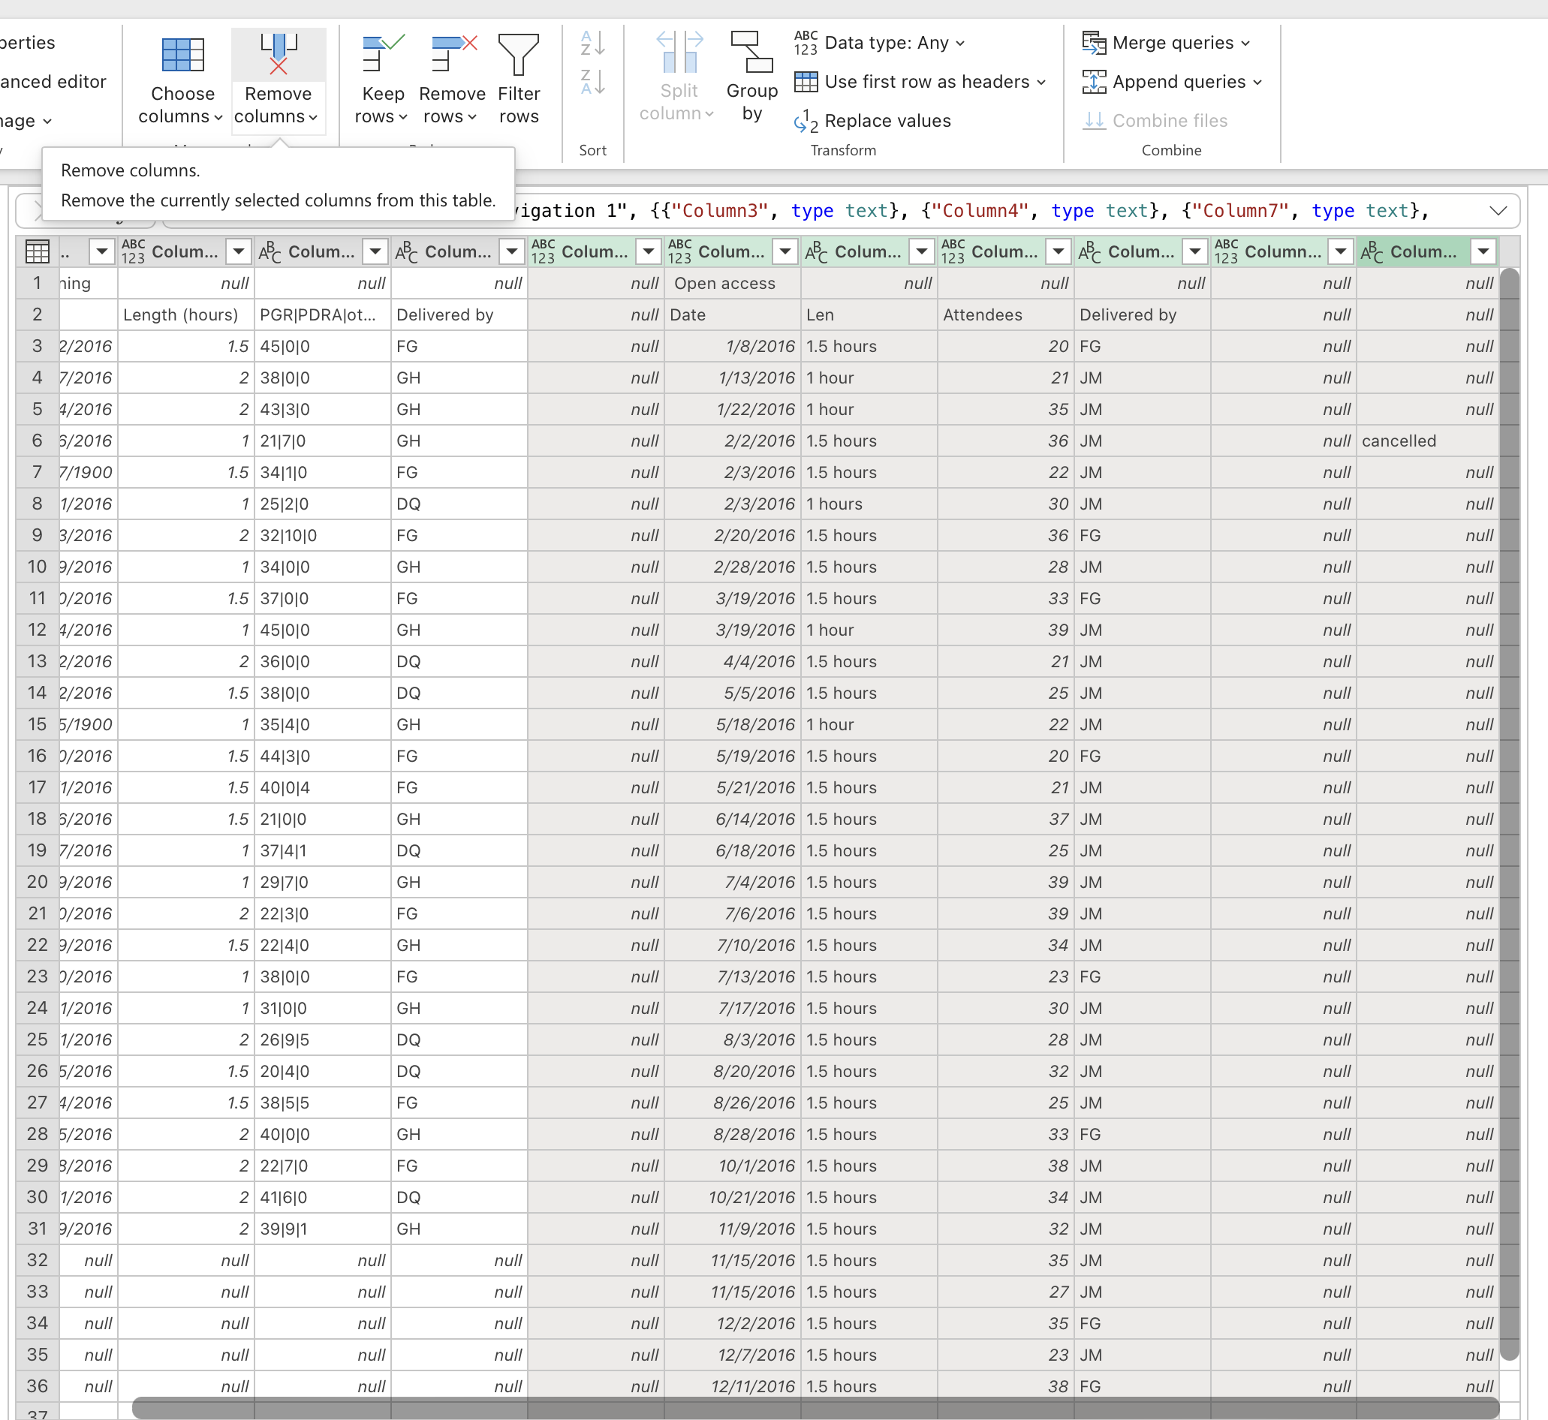
In RDM query, keep only the first 4 columns
Select remaining columns
Click “Remove columns”

Slide 45
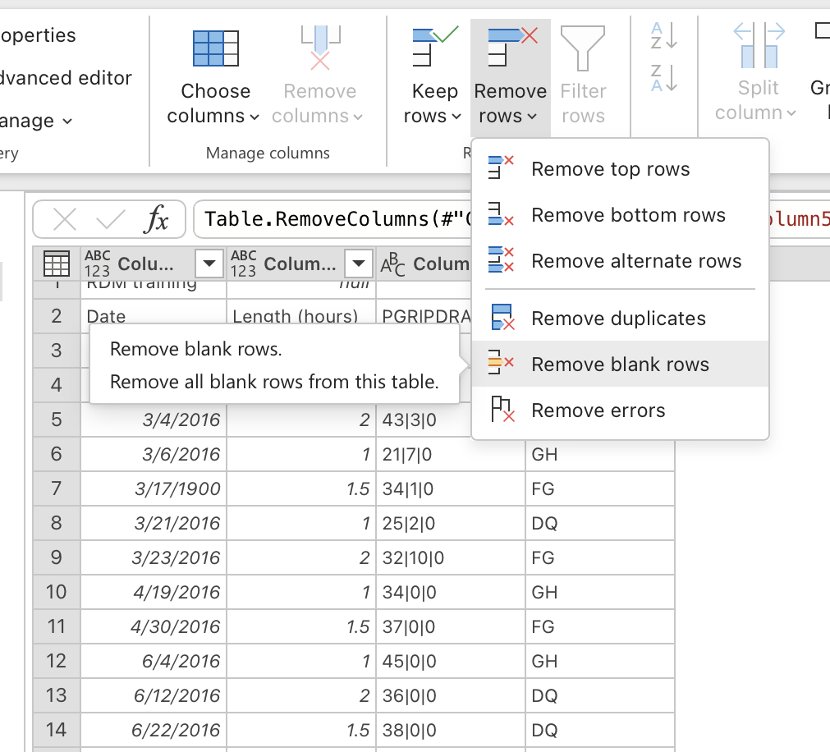
Remove blank rows
In “Remove rows” menu, select “Remove blank rows”

Slide 46
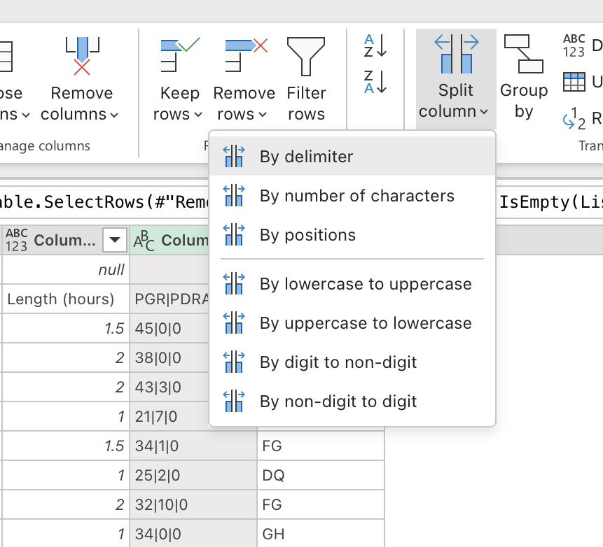
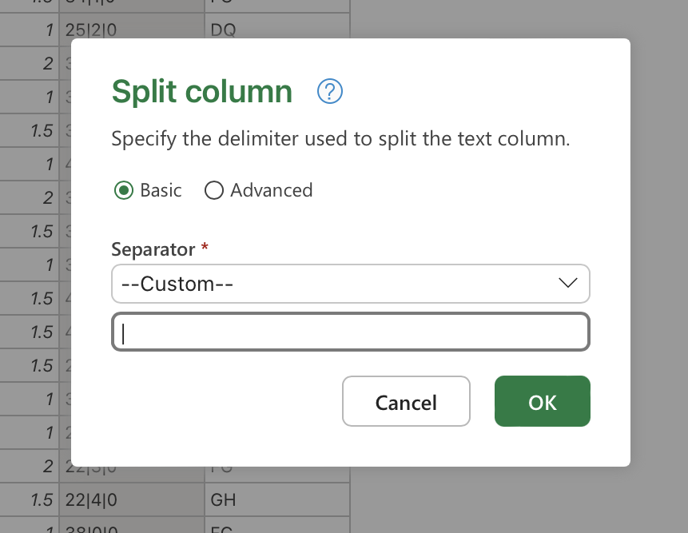
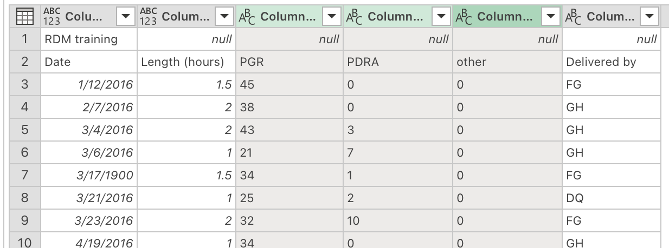
Split the third column
Column contains number of attendees of different types (post-graduate researcher (PGR), post-doctoral research associate (PDRA), and other)
Select “PGR|PDRA|other” column
Click “Split column”
Select “By delimiter”
For Separator, select “--Custom--”
Type “|” as the separator

Slide 47
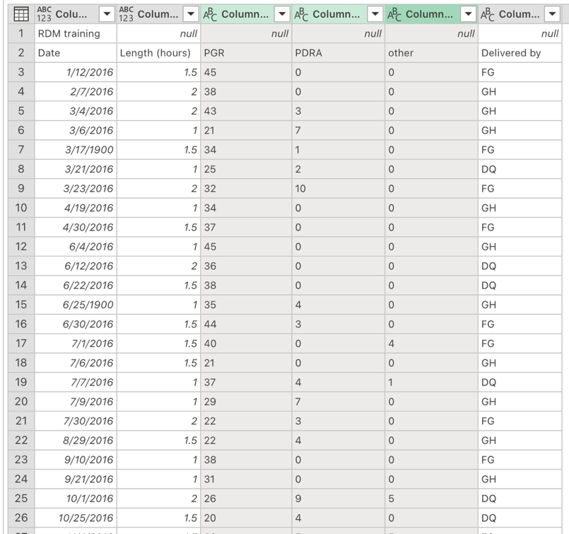
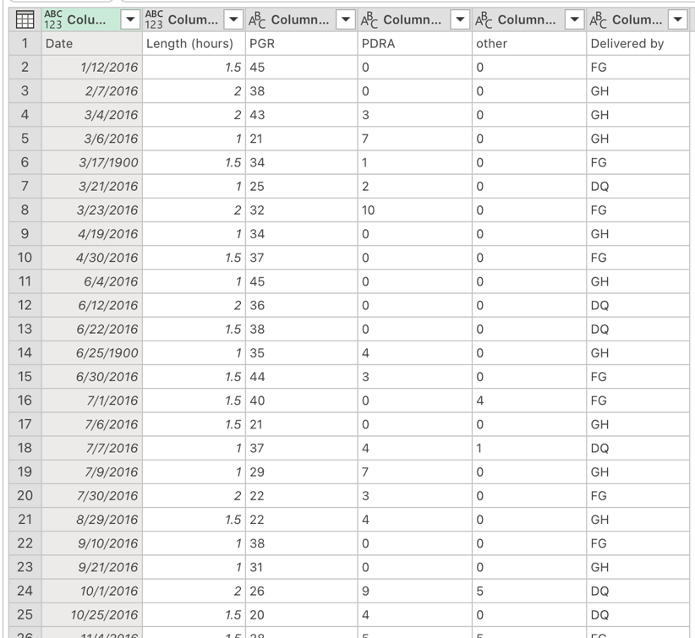
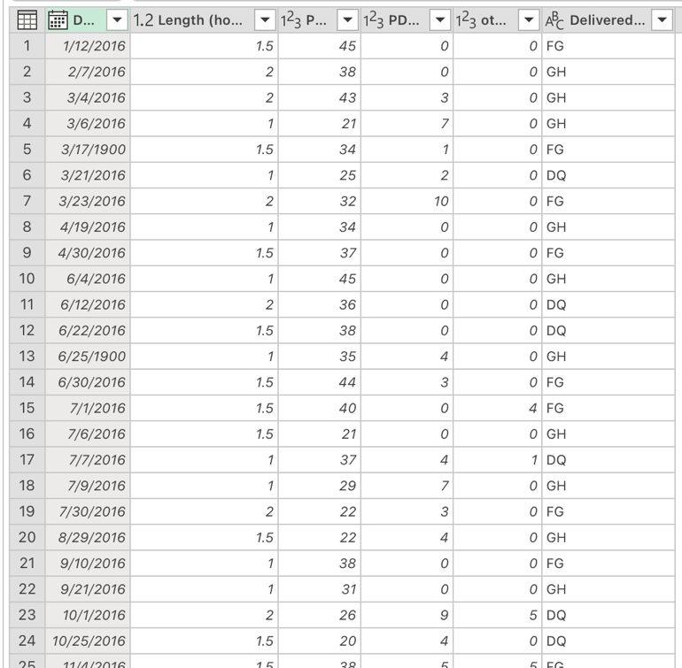
Use correct column headers
Remove top 1 row
Use first row as headers

Slide 48
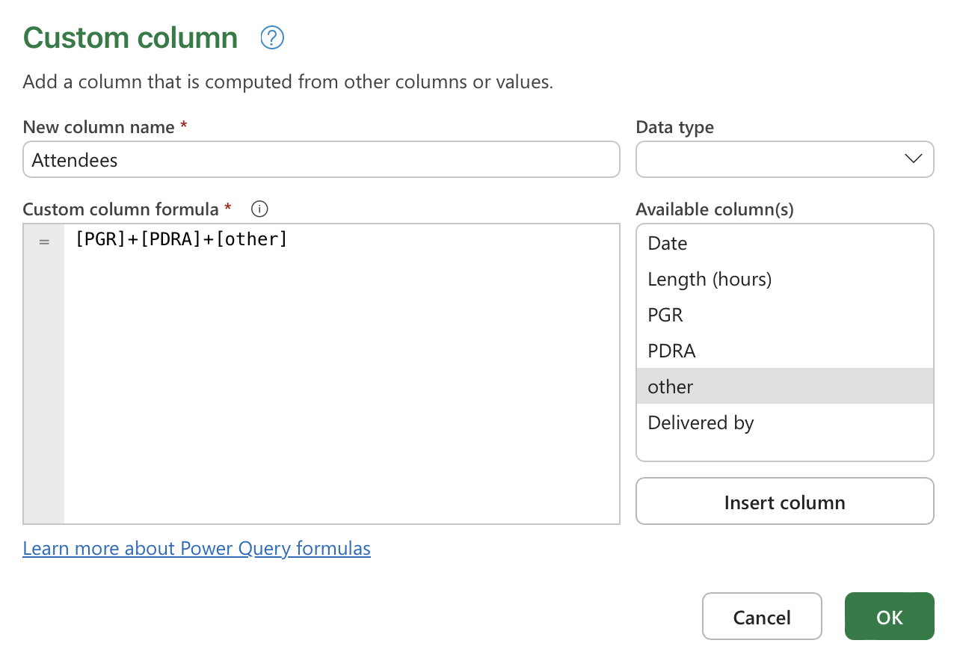
Calculate total attendees
Click on “Add column” in ribbon menu
Select “Custom column”
Name the column “Attendees”
In the formula box:
Insert “PGR” column from the right
Add “+”
Insert “PDRA” column
Add “+”
Insert “other” column
Click OK

Slide 49
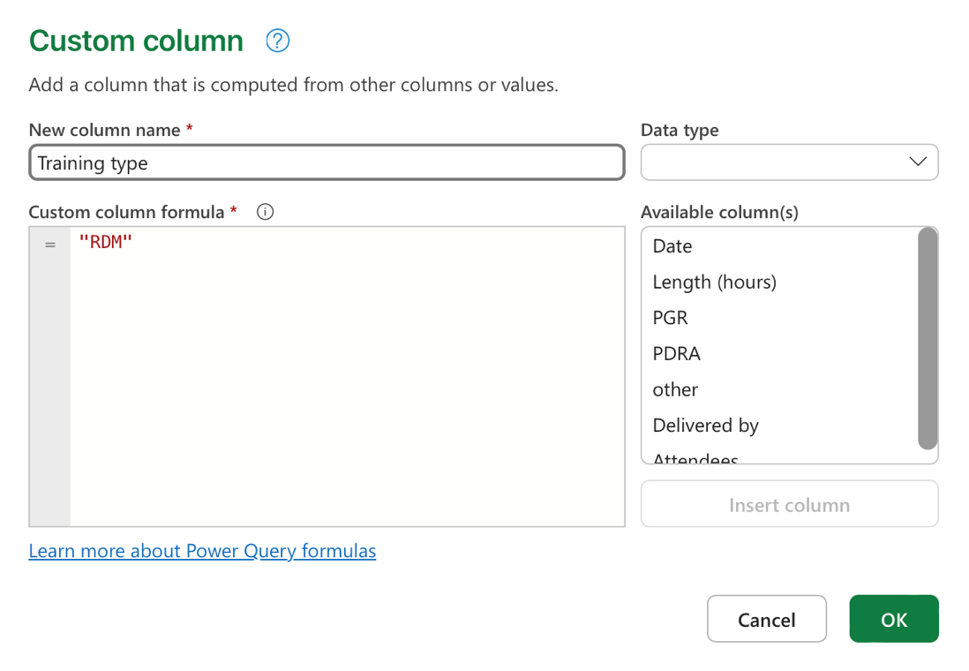
Add a column to indicate training type
Since we’ll be combining this table with the Open Access training table, we need the data in this table to be labelled with “RDM.”
Add another “Custom column”
Name the column “Training type”
In the formula box, type "RDM"

Slide 50
Switch to “Open access” and clean that table as well
Remove first 5 columns
Use correct column headers
In “Len” column, use “replace values” to replace “ hours” and “ hour” with nothing
In “Len”, use Format → Trim to remove any remaining whitespace
Change “Len” data type to “Decimal number”
Rename column from “Len” to “Length (hours)”
Delete empty 4th column
Rename final column to “Cancelled”
Add a custom column called “Training type” with the value “Open access”

Slide 51
Combine the two tables into one with “append”
Under “Home”, click “Append queries”
Select “Append queries as new”
Select “RDM” as first table and “Open access” as second table
Rename Query from “Append” to “2016 Trainings”
Optional: remove the extra attendance columns
Close and load data back into Excel

Slide 52
Quick check-in with small groups, Short break
10 minutes

Slide 53
Example data project: Merging data from multiple sources
20 minutes

Slide 54
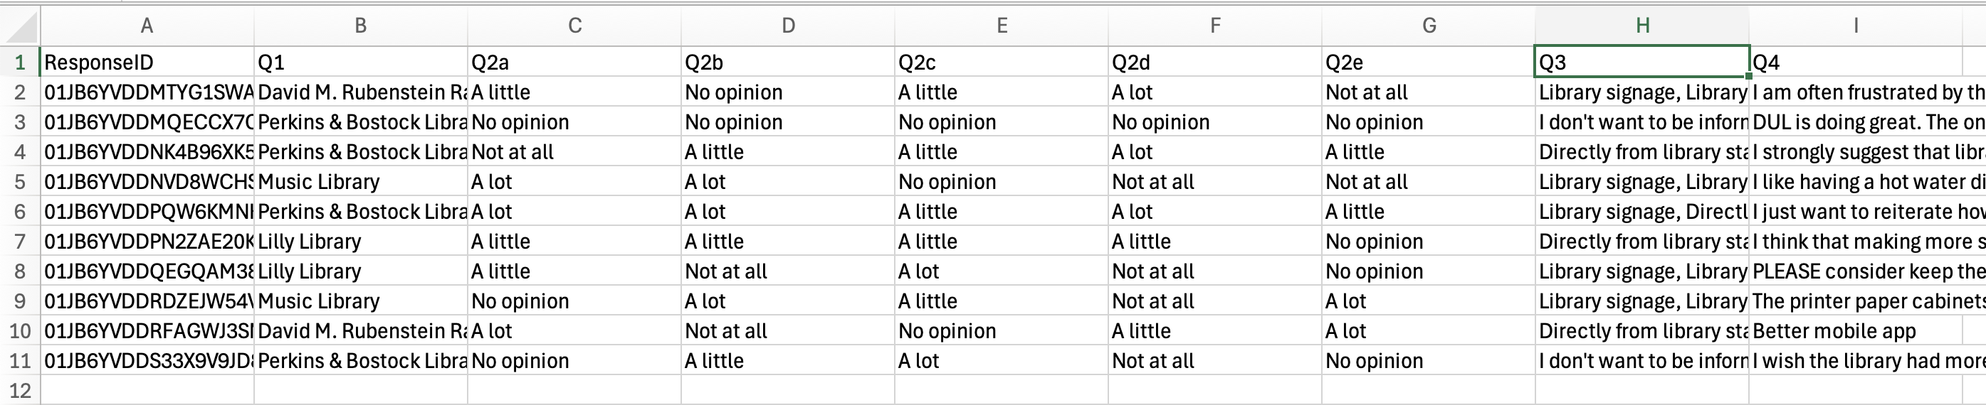
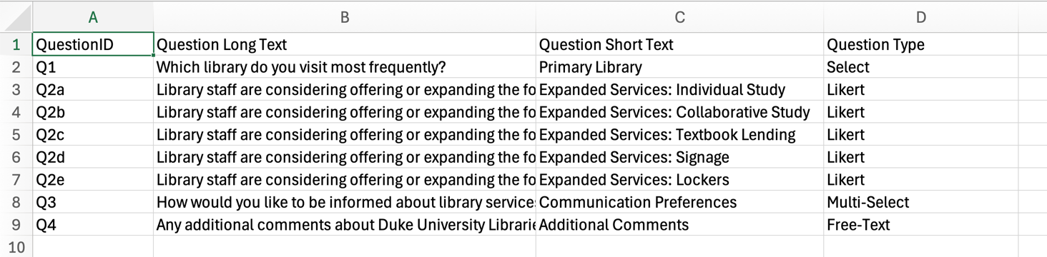
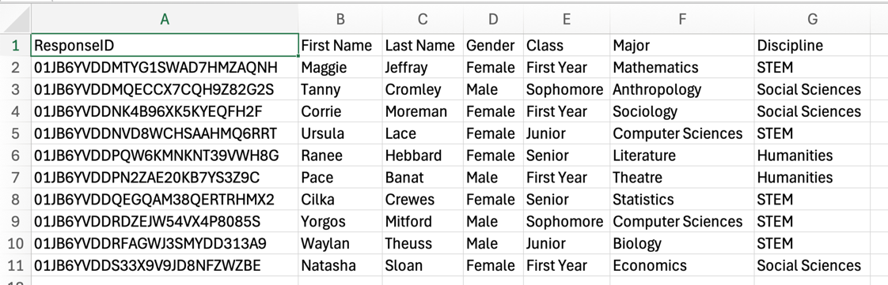
Simulated survey data
survey-responses.csv
survey-question-details.csv
survey-participant-details.csv

Slide 55
Clean responses data (try on your own)
New blank workbook
Load survey responses data (“Text/CSV”)
Use first row as headers
Split Q3 column (multi-select) on comma
Trim whitespace for the resulting columns
Unpivot all questions columns (Q1 to Q4)
Rename columns:
“Attribute” to “QuestionID”
“Value” to “Response”
In QuestionID column, replace values to clean up Q3 split column headers
Hint: look at column filter to see all values in column

Slide 56
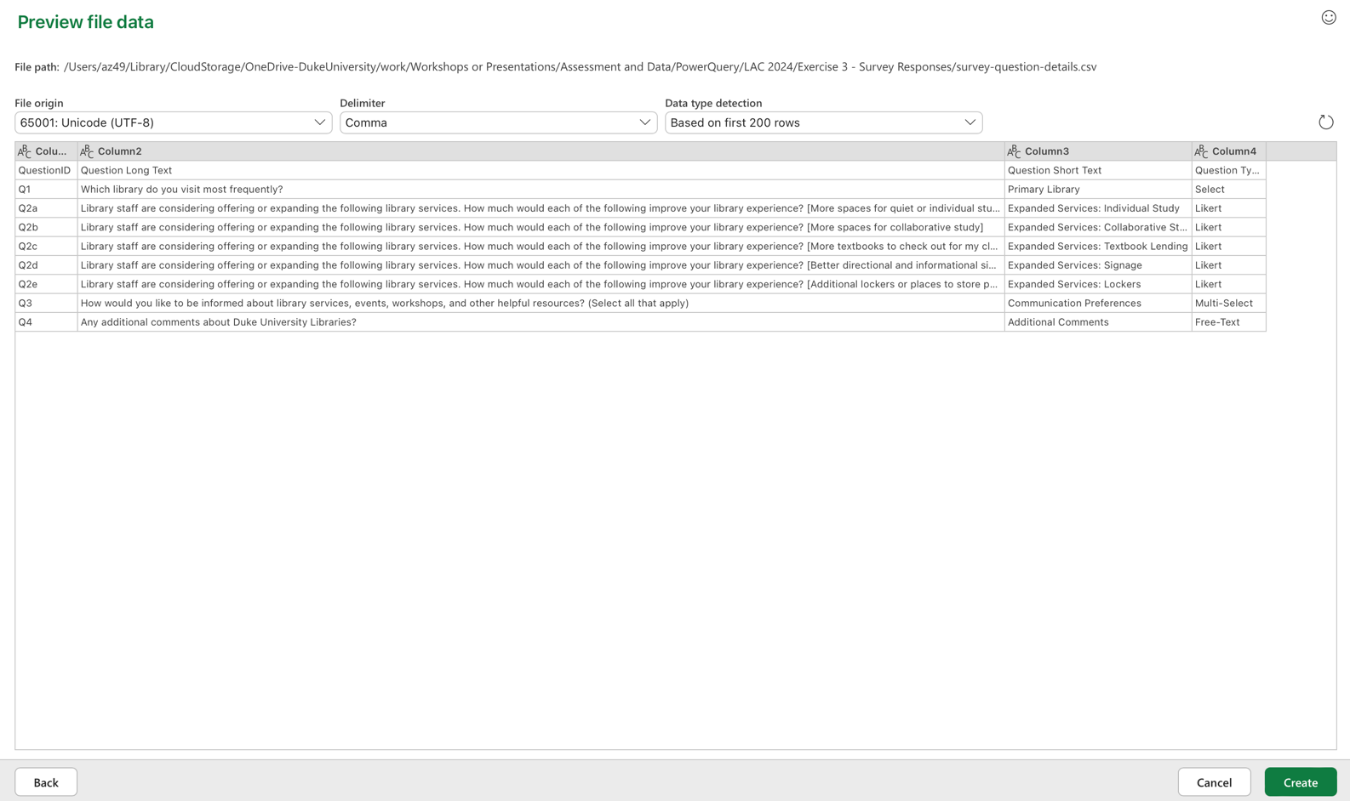
Create new query to bring in question details
In “Home”, click “Get data”
Select “Text/CSV”
Select question details file
Preview data and click “Create”
Use first row as headers

Slide 57
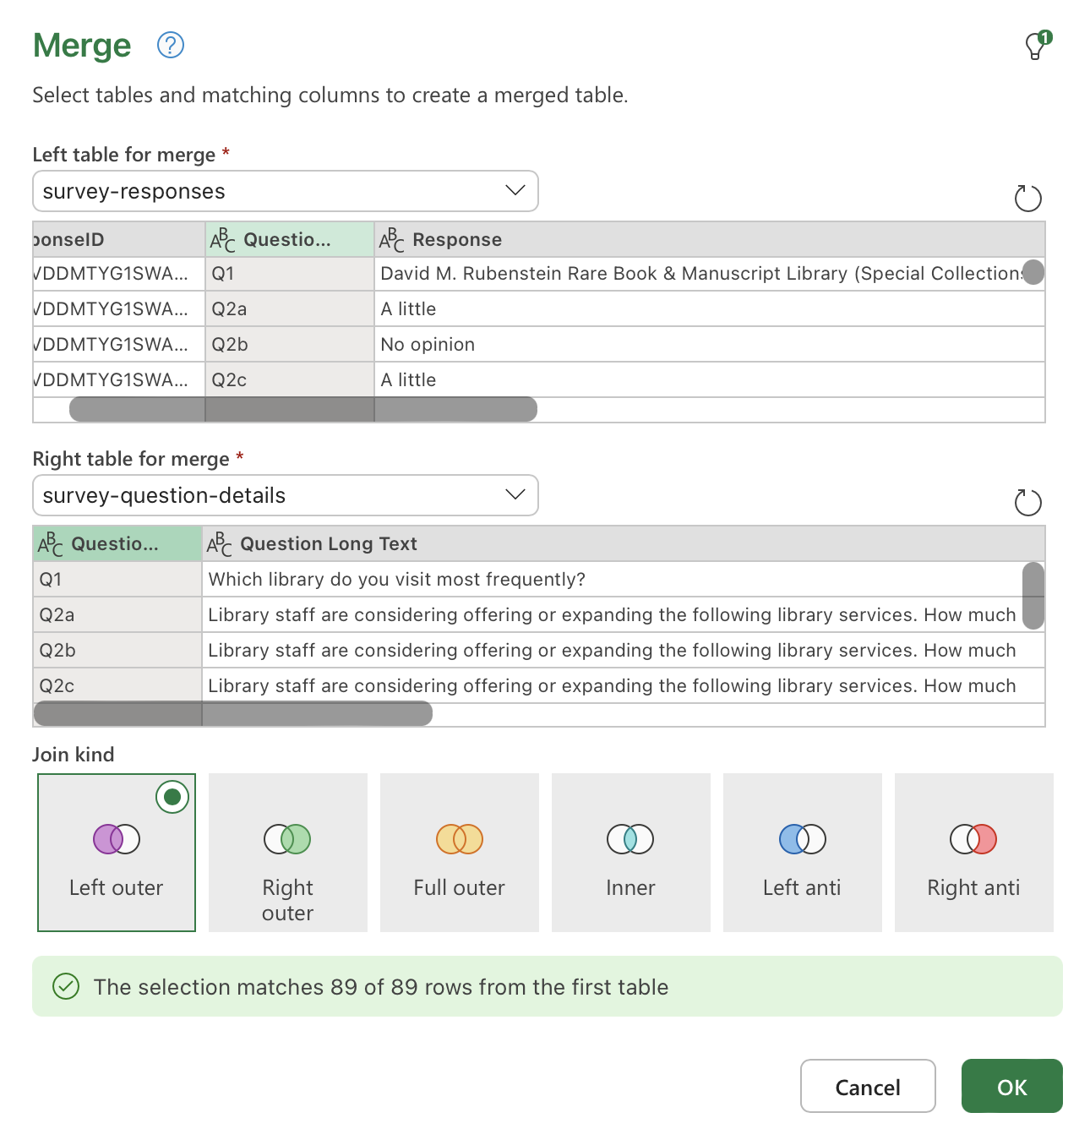
Blend the tables with “Merge queries”
Under “Merge queries”, select “Merge queries as new”
A “merge” is like a database “join”
For the “left” table, use survey responses
In the data preview, select the QuestionID column
For the “right” table, use question details
In the data preview, select the QuestionID column again
Leave the “join kind” as “Left outer”
Click OK
Rename new query as “responses-questions”

Slide 58
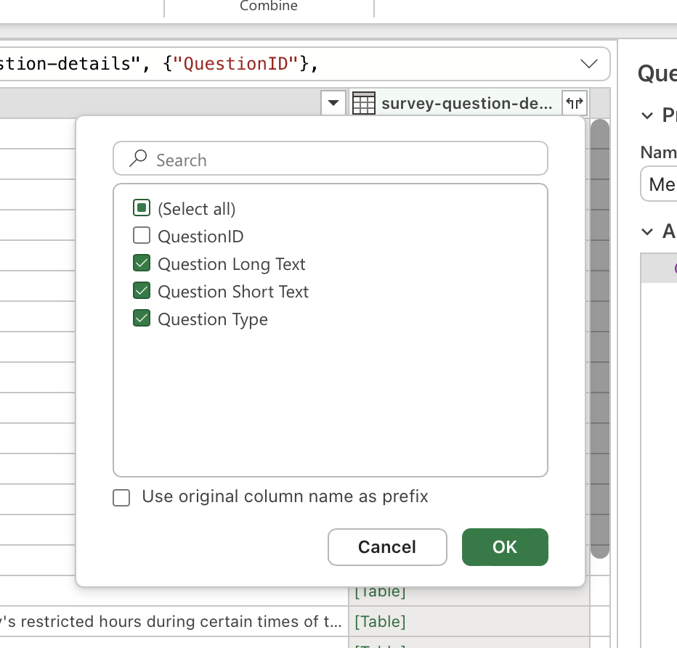
Decide what columns to bring in
Scroll right to “survey-question-details” column
Click on “expand” icon at the top
Select columns to include, or leave all selected
Can uncheck “QuestionID”, since it’s a duplicate
Click OK
New columns will be added to the right

Slide 59
Optional: repeat merge process for participant details
Create new query to bring in participant details
Use first row as headers
Merge queries as new
Use “responses-questions” as left table, select ResponseID
Use participant details as right, select ResponseID
Click OK
Rename query as “fully-merged”
Expand column at the end, include only demographics columns
Close & Load

Slide 60
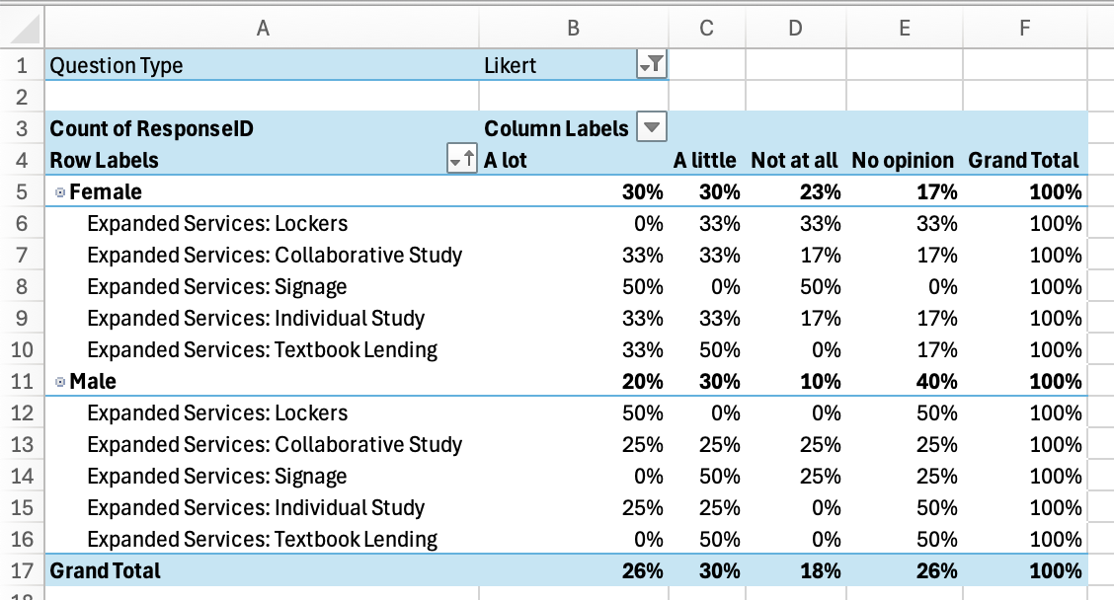
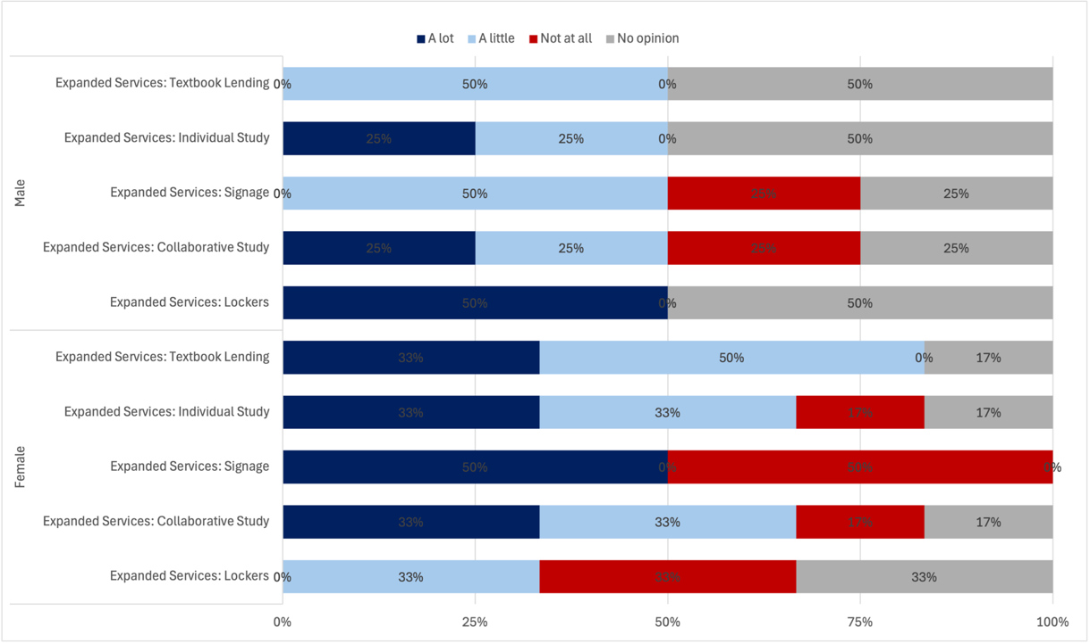
Examples of what is now possible

Slide 61
Small group reflection
15 minutes

Slide 62
Discussion questions
Are any of these examples similar to tasks you’ve had to do in the past?
How do these methods compare with your usual methods?
What questions do you still have about Power Query?

Slide 63
Full group Q&A session
15 minutes

Slide 64
Questions?
Angela Zoss, angela.zoss@duke.edu

